Slide 1
System of Linear
Equations
Course : MATH6183 – Scientific Computing
Year : 2021

Slide 2
Outlines
LU Decomposition Methods
Pivoting
Gauss-Seidel Method

Slide 3
Linear Equation Notation
A set of n linear equations in n variables, x_{i}
Can be written in matrix form, Ax = b:

Slide 4
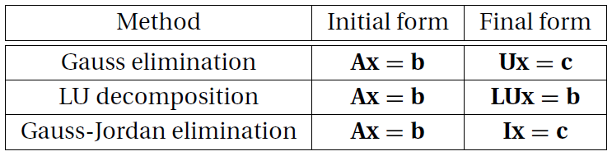
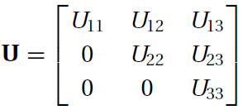
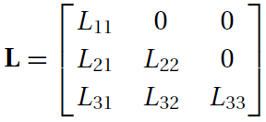
Overview of Direct Method
The following table lists three popular direct methods, each of which uses elementary operations to produce its own final form of easy-to-solve equations.
In the table, U represents an upper triangular matrix, L is a lower triangular matrix, and I denotes the identity matrix.

Slide 5
Gaussian Elimination (1/2)
Consider a system of 3 × 3 linear equations in
matrix form, Ax = b: represent by an augmented
matrix:
We can zero the first column by subtracting
a₂₁/a₁₁ times the first row from the second row,
and subtracting a₃₁/a₁₁ times the first row from
the third row (primes indicate changed values)
Similarly, we can now zero the second column
by subtracting a’₃₂/a’₂₂ times the first row from
the third row (double primes indicate changed
values), forming an upper triangular matrix:

Slide 6
Gaussian Elimination (2/2)
The last row represents an equation in a
single variable a”₃₃ x₃ = b”₃ which can be solved as
x₃ = b”₃ / a”₃₃
The second row represents an equation in two variables a’₂₂ x₂ + a’₂₃ x₃ = b’₂
Since the variable x₃ has already been found in the previous step, x₂ can be solved as x₂ = (b’₂ – a’₂₃ x₃) / a’₂₂
The first row represents an equation in three variables a₁₁ x₁ + a₁₂ x₂ + a₁₃ x₃ = b₁
Since the variables x₂ and x₃ have already been found in the previous steps, x₁ can be solved as
x₁ = (b₁ – a₁₂ x₂ – a₁₃ x₃) / a₁₁

Slide 7
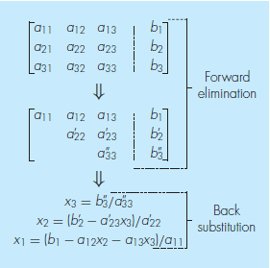
Gaussian Elimination (2/2)
The two phases of Gauss elimination:
- forward elimination and
- back substitution
The primes indicate the number of times that the coefficients and constants have been modified.

Slide 8
Scientific Computing
Scientific Computing is the collection of tools, techniques, and theories required to solve on a computer mathematical models of problems in Science and Engineering (Golub and Ortega, 1992).
A majority of these tools, techniques, and theories originally developed in Mathematics. many of founded long before the advent of electronic computers. This set is called Numerical Analysis (or Numerical Methods) and constitutes a major part of scientific computing.
Programming Language:
Fortran, MATLAB, Scilab, GNU-Octave, Mathematica, Python
Gene H. Golub and James M. Ortega. Scientific Computing and Differential Equations – An Introduction to Numerical Methods. Academic Press, 1992.

Slide 9
Example 1
Solve the system of equations the augmented matrix :
Solution
We introduce a lower triangular matrix, L, to record
row multipliers in the • positions
Calculate the row multipliers and record them in the
L matrix, l₂₁ = a₂₁/a₁₁ and l₃₁ = a₃₁/a₁₁
Zero the first column by subtracting l₂₁ = a₂₁/a₁₁ times the first row from the second row, and subtracting l₃₁ = a₃₁/a₁₁ times the first row from the third row

Slide 10
Example 1
Calculate the row multiplier and record it in the L
matrix, l₃₂ = a’₃₂/a’₂₂
Zero the second column by subtracting l₃₂ = a’₃₂/a’₂₂ times the second row from the third row, forming an upper triangular matrix
The last row represents a”₃₃ z = b”₃, so that z = b”₃ / a”₃₃ = –7 / –7 = 1
The second row represents a’₂₂ y + a’₂₃ z = b’₂, so that y = (b’₂ a’₂₃ z) / a’₂₂ = (–6 + 2) / (–2) = 2
The first row represents a₁₁ x + a₁₂ y + a₁₃ z = b₁, so that x₁ = (b₁ – a₁₂ y – a₁₃ z) / a₁₁ = (4 – 2 – 1) / 1 = 1
The solution is thus x = 1, y = 2, z = 1.

Slide 11
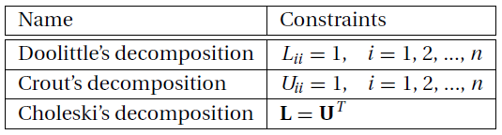
LU Decomposition
Any square matrix A can be expressed as a product of a lower triangular matrix L and an upper triangular matrix U:
A = LU
The process of computing L and U for a given A is known as LU decomposition or LU factorization.
LU decomposition is not unique (the combinations of L and U for a prescribed A are endless), unless certain constraints are placed on L or U. These constraints distinguish one type of decomposition from another. Three commonly used decompositions are

Slide 12
LU Decomposition
After decomposing A, it is easy to solve the equations
Ax = b.
First rewrite the equations as LUx = b. Upon using the notation Ux = y, the equations become
Ly = b
which can be solved for y by forward substitution. Then
Ux = y
will yield x by the back substitution process.

Slide 13
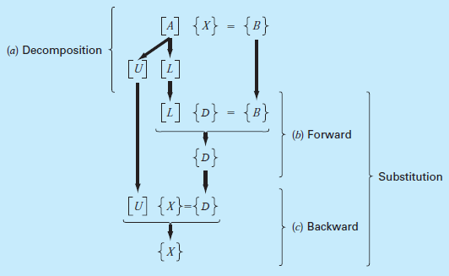
LU Decomposition Steps

Slide 14



Doolittle’s Decomposition Method
Consider a 3 × 3 matrix A and assume that there exist triangular matrices
such that A = LU. After completing the multiplication on the right-hand side, we get
apply Gauss elimination to A. The first pass of the elimination procedure consists of choosing the first row as the pivot row and applying the elementary operations

Slide 15
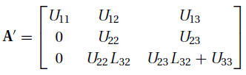


Doolittle’s Decomposition Method
The result is
In the next pass we take the second row as the pivot row and utilize the operation
ending up with
The final form of the coefficient matrix would thus be the following
mixture of L and U:

Slide 16
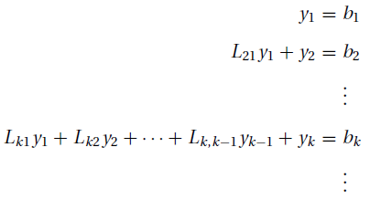

Doolittle’s Decomposition Method
Consider now the procedure for the solution of Ly = b by forward substitution. The scalar form of the equations is (recall that L_{ii} = 1)
Solving the k^{th} equation for y_{k} yields

Slide 17



Example 2
Use Doolittle’s decomposition method to solve the equations Ax = b, where
Solution
The first decompose A by Gauss elimination. The first pass consists of the elementary operations
Storing the multipliers L₂₁ = 1 and L₃₁ = 2 in place of the eliminated terms, we obtain

Slide 18
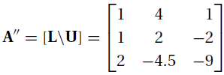
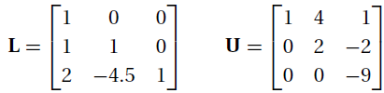

Example 2
The second pass of Gauss elimination uses the operation
Storing the multiplier L32 = −4.5 in place of A32, we get
The decomposition is now complete, with
Solution of Ly = b by forward substitution comes next. The augmented coefficient form of the equations is

Slide 19
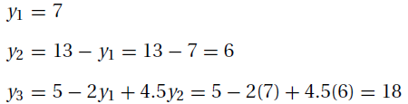
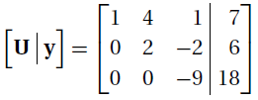
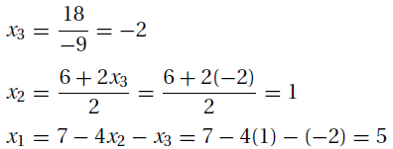
Example 2
The solution is
Finally, the equations Ux = y, or
are solved by back substitution. This yields

Slide 20
Example 3 : Gauss-Jordan Elimination
The Gauss–Jordan method is essentially Gauss elimination taken to its limit. In the Gauss elimination method only the equations that lie below the pivot equation are transformed. In the Gauss–Jordan method the elimination is also carried out on equations above the pivot equation, resulting in a diagonal coefficient matrix.
Solve
Solution
The augmented matrix of this system is

Slide 21
Example 3 : Gauss-Jordan Elimination
a b
c
d
Replace row1 with ¹/₂ * row1 + 0 * row2
Replace row2 with row2 – 4 * row1
Negate row2
Replace row1 with row1 + ³/₂ * row2
Read off solution: x₁ = 2, x₂ = 1

Slide 22
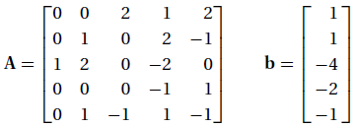


Exercise
Use Gauss elimination to solve the equations Ax = b, where
Use Gauss-Jordan elimination to solve the equations Ax = b, where
Find L and U using Doolittle’s decomposition so that

Slide 23
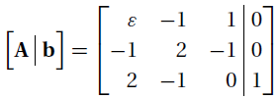
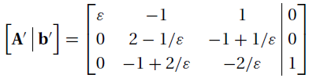
Pivoting: Introduction
Row pivoting is required if the pivot element is not zero, but very small in comparison to other elements in the pivot row, as demonstrated by the following set of equations:
After the first phase of Gauss elimination, the augmented coefficient matrix becomes

Slide 24
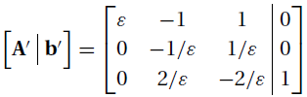
Pivoting: Introduction
If ε is very small, then 1/ε is huge, and an element such as 2 − 1/ε is rounded to −1/ε. Therefore, for sufficiently small ε, the last equation are actually stored as
Because the second and third equations obviously contradict each other, the solution process fails again.
The example illustrates the extreme case where ε was so small that roundoff errors resulted in total failure of the solution. If we were to make ε somewhat bigger so that the solution would not “bomb” any more, the roundoff errors might still be large enough to render the solution unreliable. Again, this difficulty could be avoided by pivoting.

Slide 25



Diagonal Dominance
An n ×n matrix A is said to be diagonally dominant if
For example, the matrix
is not diagonally dominant, but if we rearrange the rows in the following manner:
then we have diagonal dominance
The strategy of pivoting should be to reorder the equations so that the coefficient matrix is as close to diagonal dominance as possible.

Slide 26


Scaled Row Pivoting
Establish an array s with the elements
Thus, s_{i} , called the scale factor of row i, contains the absolute value of the largest element in the i^{th} row of A.
The relative size of an element Aij is defined as the ratio

Slide 27
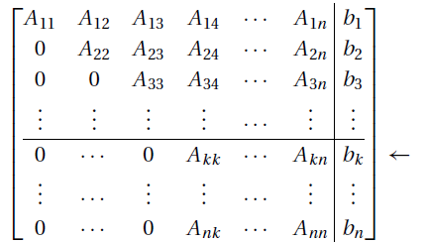

Scaled Row Pivoting
Suppose that the elimination phase has reached the stage where the k^{th} row has become the pivot row. The augmented coefficient matrix at this point is
The best choice is the element Apk that has the largest relative size, that is, we choose p such that

Slide 28
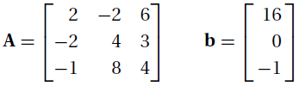
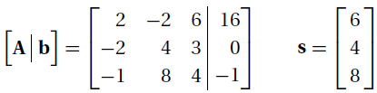

Example 3
Employ Gauss elimination with scaled row pivoting to solve the equations Ax = b, where
Solution
The augmented coefficient matrix and the scale factor array are
To determine the best pivot element, we calculate the relative sizes of the elements in the first column:

Slide 29
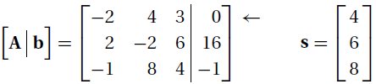
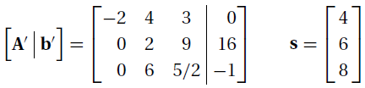
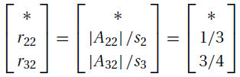
Example 3
r₂₁ is the biggest element, so that A₂₁ makes the best pivot element. Therefore, we exchange rows 1 and 2 of the augmented coefficient matrix and the scale factor array, obtaining
the first pass of Gauss elimination is carried out, yielding
The potential pivot elements for the next elimination pass are A₂₂ and A₃₂. We determine the “winner” from

Slide 30
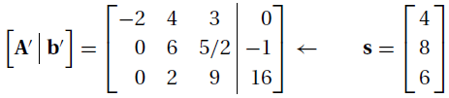
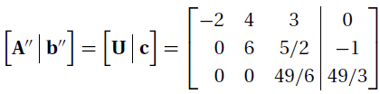
Example 3
r₁₂ is irrelevant, since row 1 already acted as the pivot row. As r₃₂ is bigger than r₂₂, the third row is the better pivot row. After interchanging rows 2 and 3, we have
The second elimination pass now yields
Because the solution of Ux = c by back substitution is not affected by pivoting, we skip the details computation. The result is x^{T} = [1 -1 2]

Slide 31


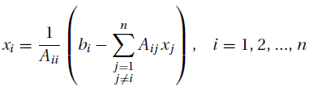
Gauss–Seidel Method
The equations Ax = b are in scalar notation
Extracting the term containing x_{i} from the summation sign yields
Solving for x_{i}, we get

Slide 32

Gauss–Seidel Method
Convergence can be checked using the criterion
for all i, where j and j − 1 are the present and previous iterations
εs is tolerance error

Slide 33
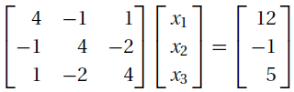
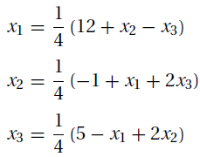
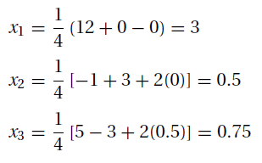
Example 4
Solve the equations by the Gauss–Seidel method without relaxation
Solution
With the given data, the iteration formulas become as left equation below. Choosing the starting values x₁ = x₂ = x₃ = 0, the first iteration gives us a right equation below

Slide 34
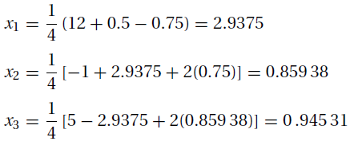
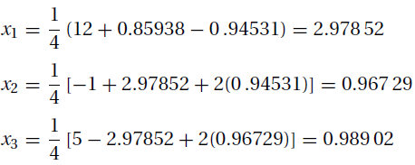
Example 4
The second iteration yields
and the third iteration results in
After five more iterations the results would agree with the exact solution x₁ = 3,x₂ = x₃ = 1 within five decimal places.

Slide 35


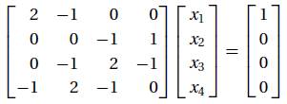
Exercise
Use the Gauss–Seidel method to solve
a. b.
2. Use Gauss elimination with scaled row pivoting to solve
.

Slide 36
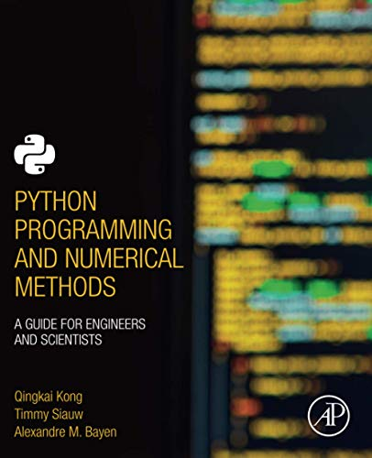
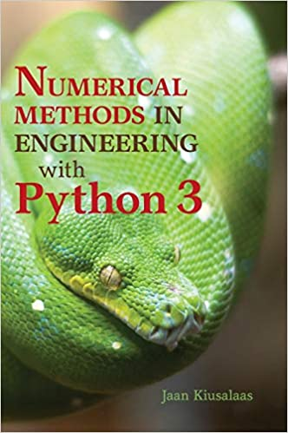
These slides have been adapted from: Kong, Q., Siauw, T., & Bayen, A. M. (2021). Python Programming and Numerical Methods: A Guide for Engineers and Scientists. Academic Press. ISBN: 978-0-12-819549-9 Kiusalaas, J. (2013). Numerical Methods in Engineering with Python 3. United Kingdom: Cambridge University Press. ISBN:9781107033856 Additional materials : Chapra, S.C (2015). Numerical Methods for Engineers. 6st Edition. McGraw-Hill Companies, Inc . New York. ISBN. 978-981-4670-87
Acknowledgement

